Slide 1
Information Security Project
Eliminating Zero-Yuan Purchases:
Finding, Cracking, and Fixing Common Vulnerabilities in Shopping Websites
13rd Jan, 2025
Group Members: Kai Ren, WeiJie Zhang, YiMing Jiang, Rui Hu, Yang Lan
Notes:
Good afternoon, professors and classmates. I am RenKai. It’s a great honor to share our group’s project with you.
Because something terrible happened to me, I hurt my face, so I have no choice but to wear a mask to do this presentation. I am so sorry.
Yeah, life is also full of bugs, we need to face them and fix them.
So is the information security. Our group project is about shopping websites.
We want to eliminate the zero Yuan Purchase, so we discover, replicate and fix some common vulnerabilities in the websites.

Slide 2





I. Introduction: Motivation
Imagine you were a HACKER.
What would you want to do with BUGS on a Shopping Website?
Anything is POSSIBLE!
Steal other people‘s accounts to buy items for FREE?
Forge coupons to realize huge DISCOUNTS?
Help paint bad feedback for website for PROFIT?
Notes:
Now, guys, imagine you were a hacker, what would you want to do with the bugs on a shopping website? Su ch as Taobao, Jingdong or Pinduoduo.
Maybe the first thing you want to do is steal WangZiYang’s account to buy items for you freely!
Or you just fake coupons. Every year, we always wait for the double eleven for discounts, but if we can fake coupons, we can let every day be double eleven, and get the huge discounts
Also, maybe you want to be a paid Internet troll (水军) to help paint bad feedbacks for website for profit.
Yeah, It sounds crazy, but if you can pinpoint the underlying vulnerability, anything is possible!

Slide 3

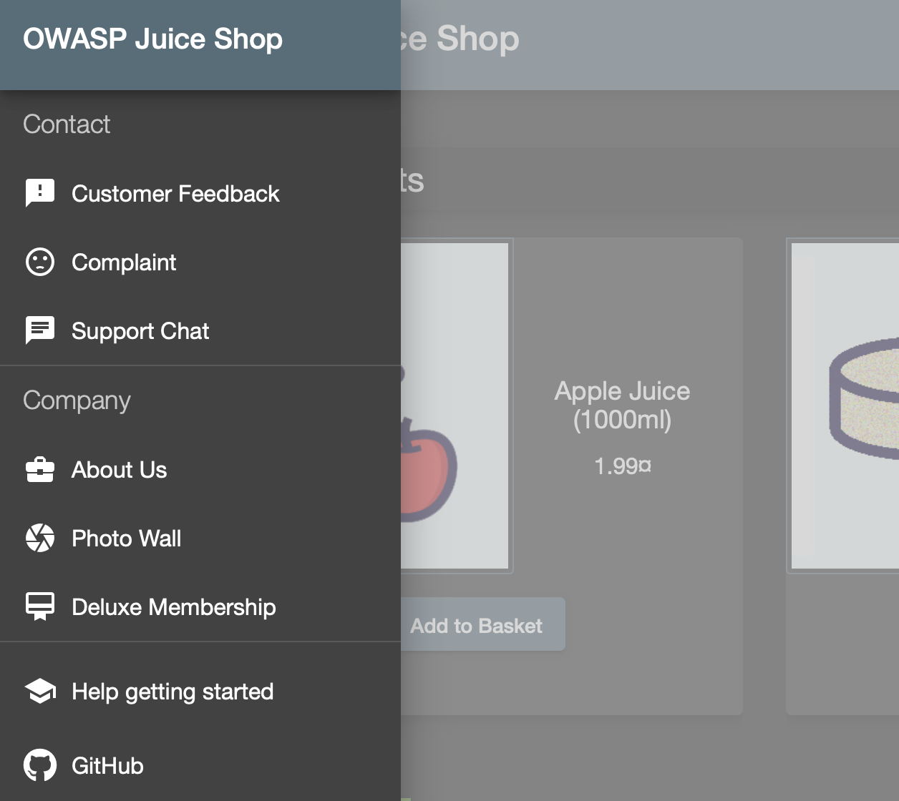
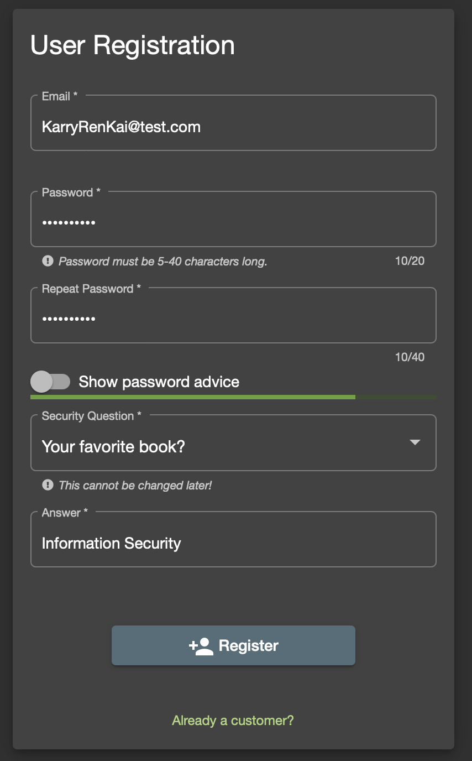
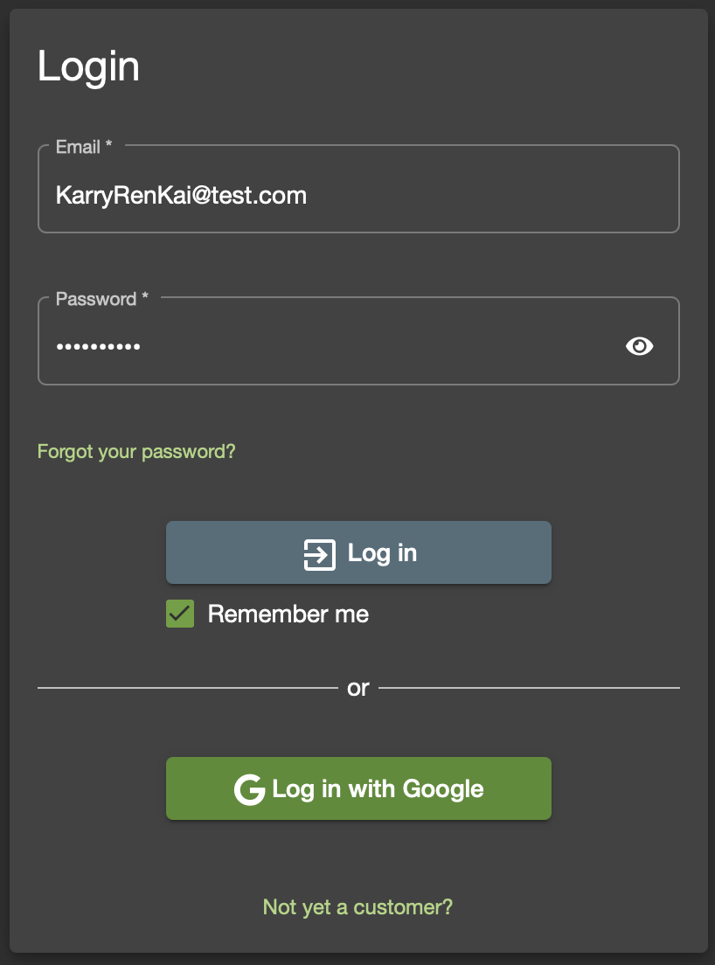
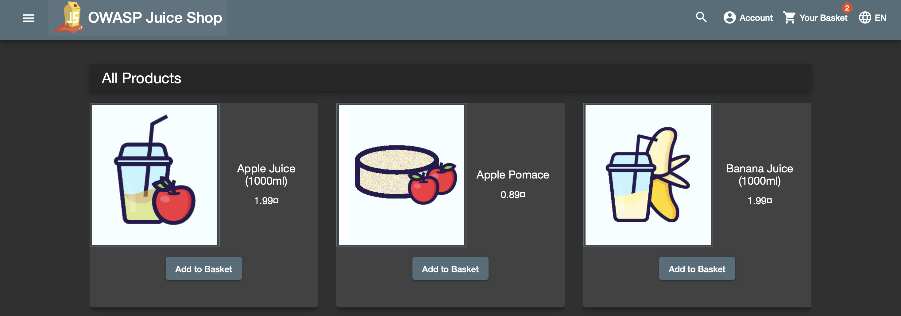
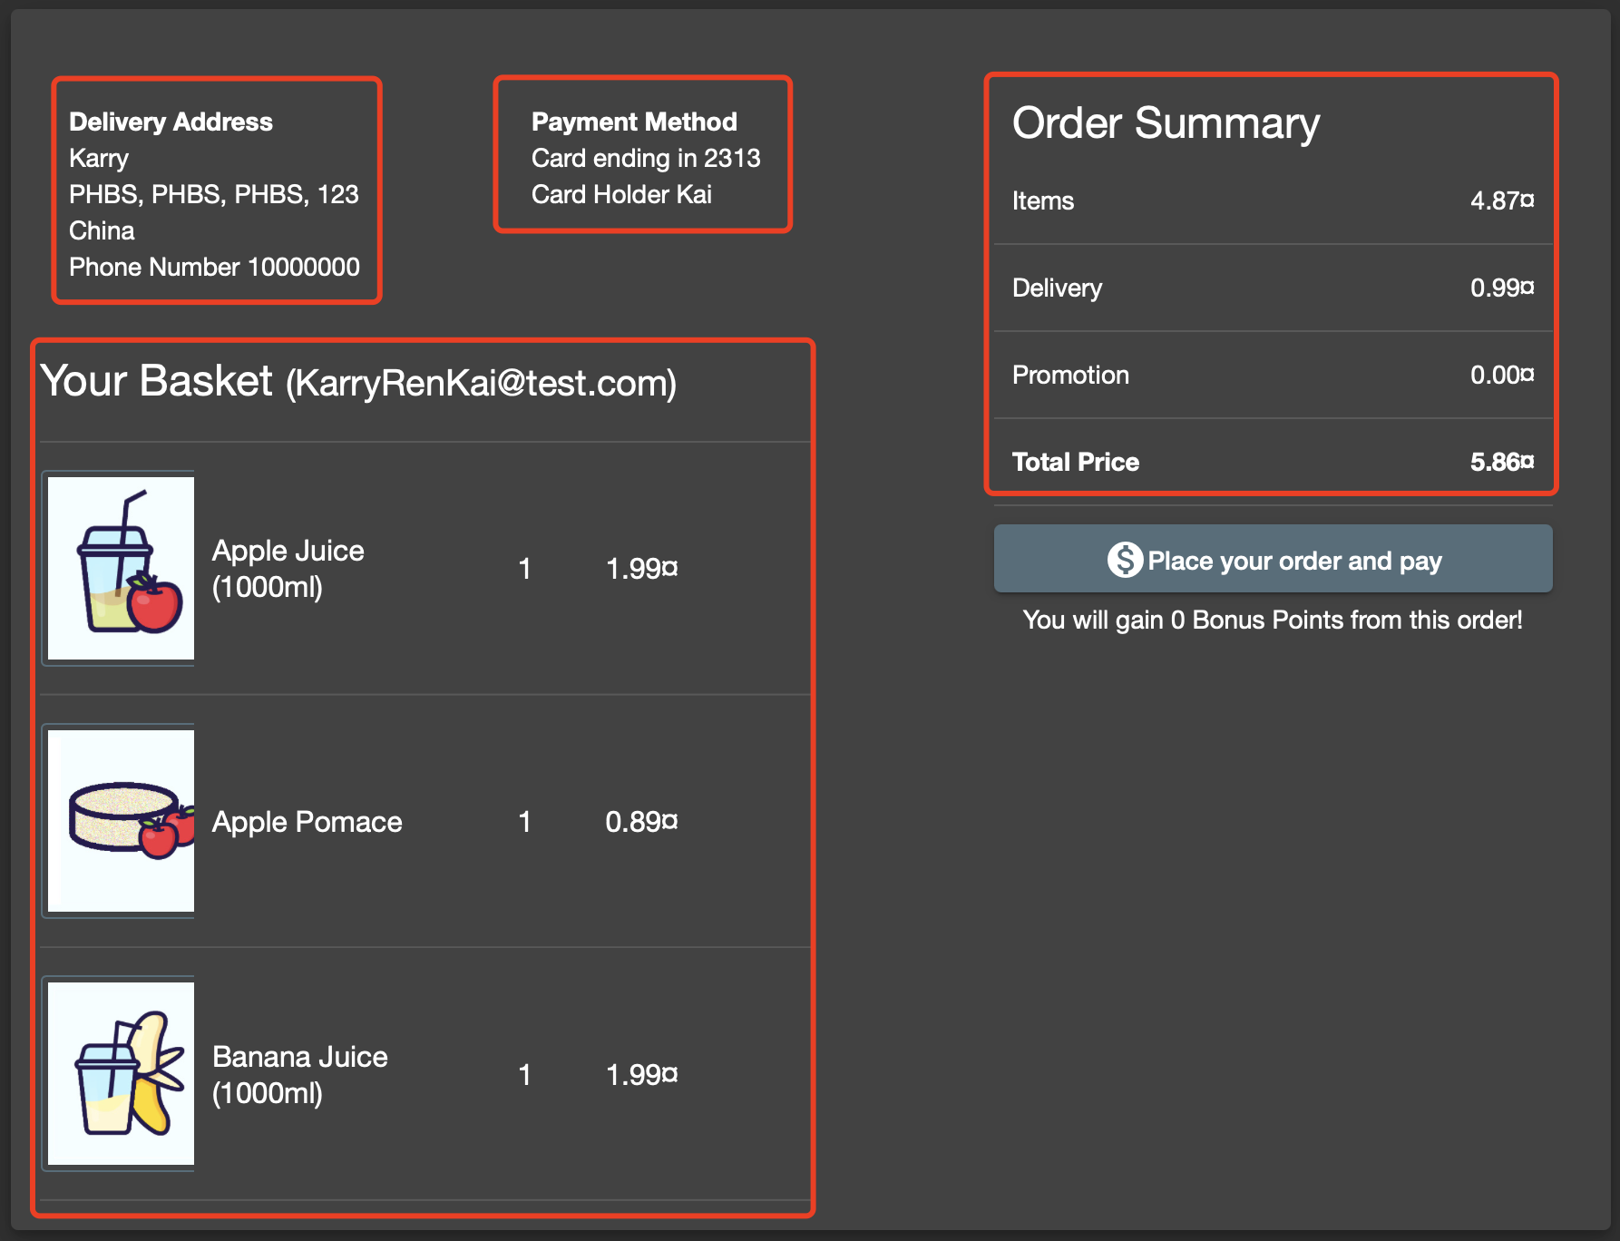
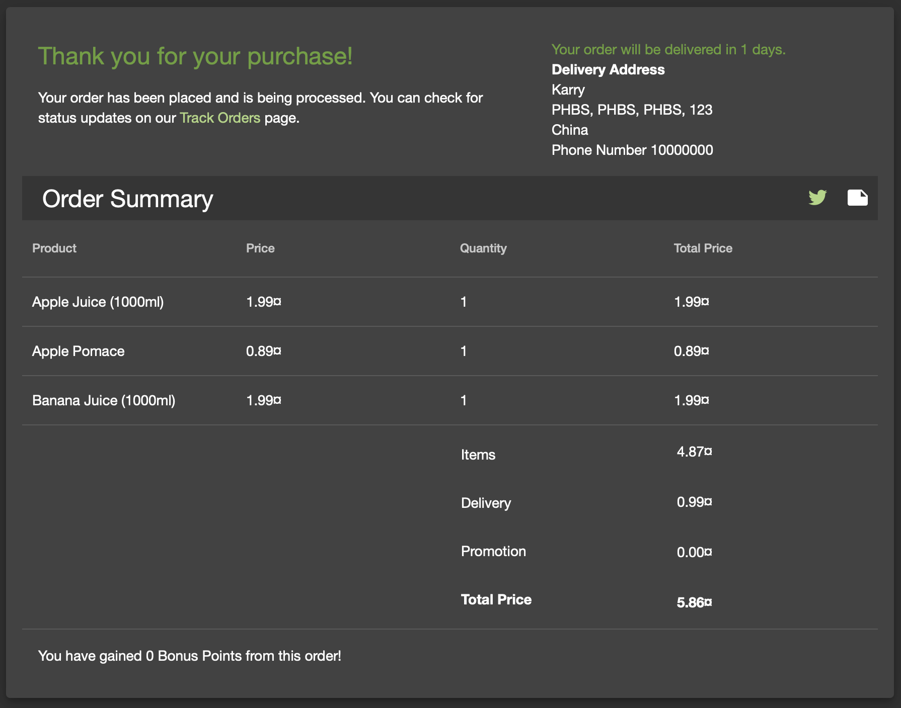
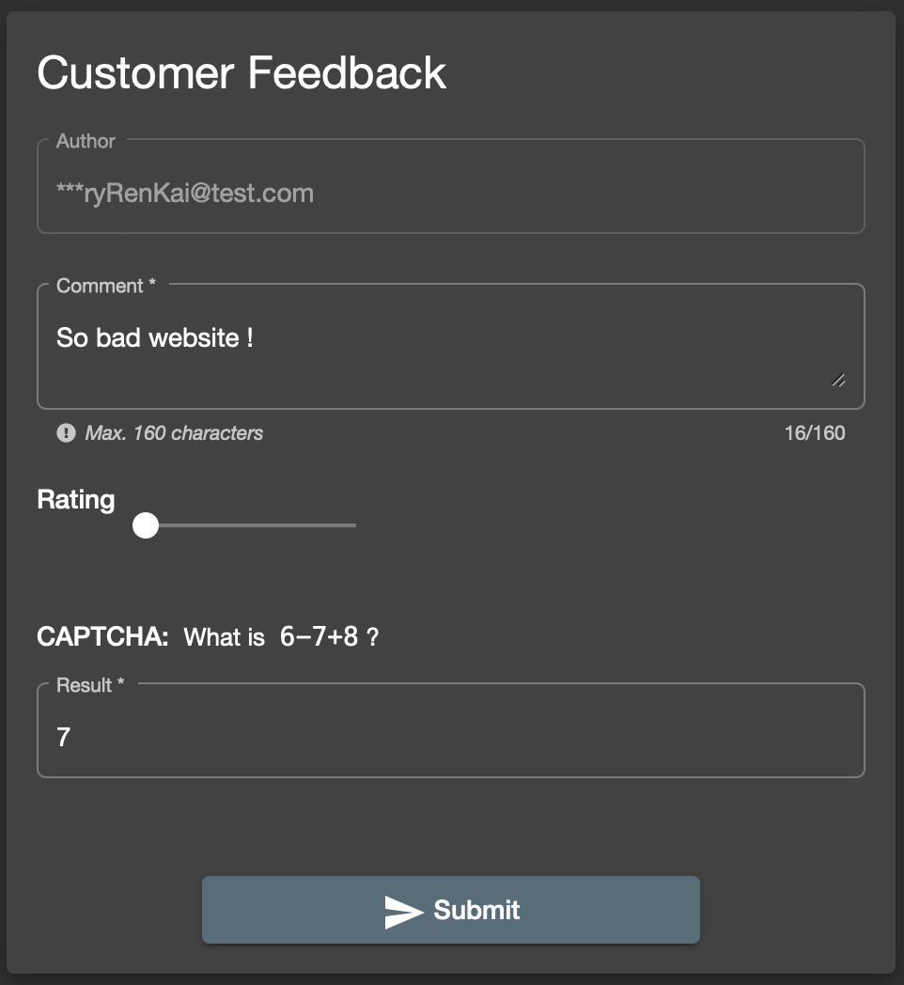
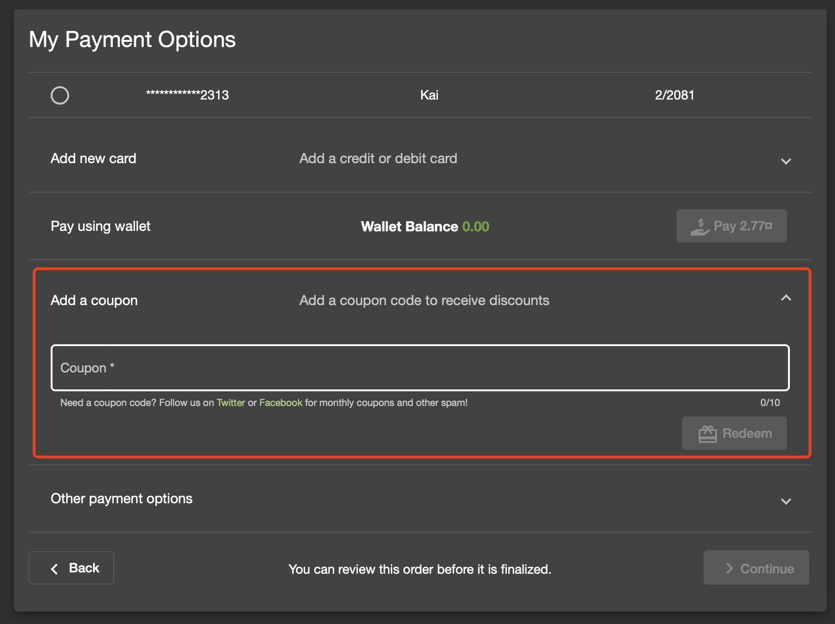
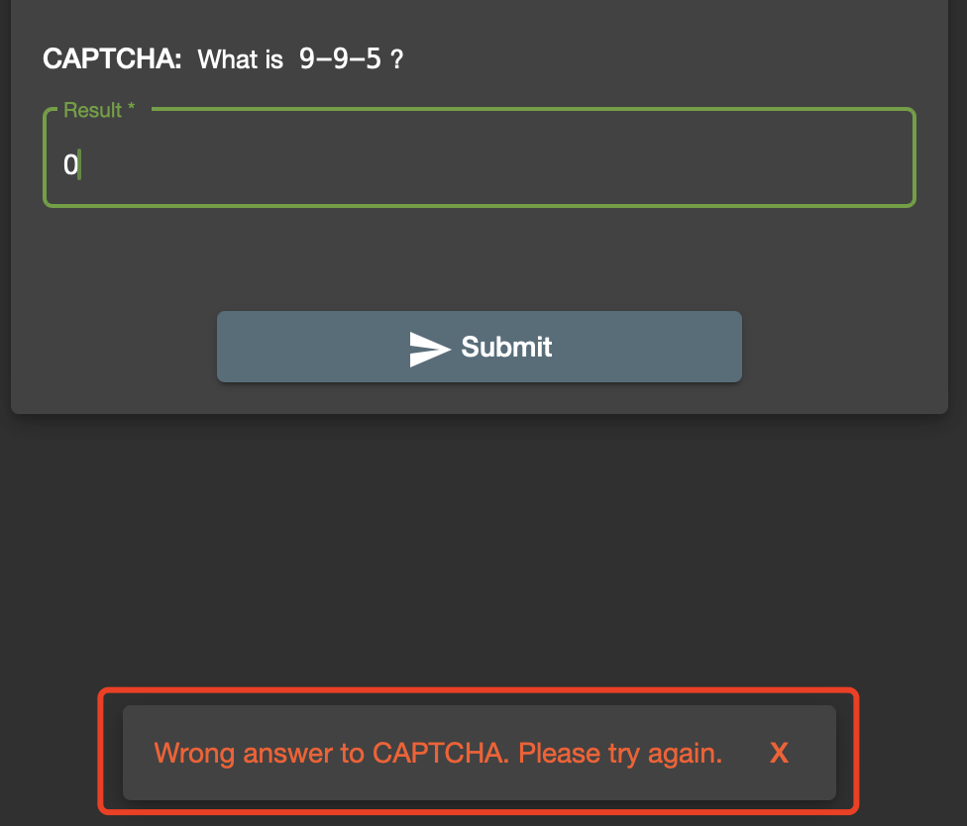
I. Introduction: Juice Shop
Figure 1.1 Main page of the juice shop.
Figure 1.2 Sign up and log in.
Figure 1.3 Choose and purchase items (you can choose a coupon).
Figure 1.4 Give feedback.
Notes:
Guess what, we really find a vulnerable Shopping Website full of bugs. It is called Juice Shop.
This is the main page of the Juice Shop website. Just like the other normal website, you can sign up for an account, and log in.
You can also add items such as juice to the basket and choose a coupon to buy.
If you feel dispointed to the website, you can also give some feedback, but you need do the right CAPTCHA.
So real, isn’t it.?

Slide 4
I. Introduction: Juice Shop
Main page of the juice shop.
Sign up and log in.
Choose and purchase items (you can choose a coupon).
Give feedback.
Notes:
Guess what, we really find a vulnerable Shopping Website full of bugs. It is called Juice Shop.
This is the main page of the Juice Shop website. Just like the other normal website, you can sign up for an account, and log in.
You can also add items such as juice to the basket and choose a coupon to buy.
If you feel dispointed to the website, you can also give some feedback, but you need do the right CAPTCHA.
So real, isn’t it.?

Slide 5

I. Introduction: Framework
Hack into shopping websites (Juice Shop) to
Find, Crack, and Fix Vulnerabilities
Motivation 1.
Steal Accounts
Motivation 2.
Forge Coupons
Motivation 3.
Paint Bad Feedback
Vulnerability 1.
SQL injection
Why: Password Free payment.
What: Do SQL injection.
How: Prepare SQL statements.
Vulnerability 2.
Reversible Encryption
Why: Encryption algorithm flaw.
What: Breaking encryption.
How: Protect files, improve encryption.
Vulnerability 3.
Bypassing CAPTCHA
Why: Plain text and port exposure.
What: Execute plaintext, look for data.
How: Encryption or change of method.
Summarize to draw conclusions and
Further Analyze with practical examples.
Why: Why do these vulnerabilities EXIST? (Find it)
What: What methods are used to CRACK the vulnerability? (Crack it)
How: How to FIX the vulnerability? (Fix it)
Highly correlated to things we learned in class.
Notes:
Based on that, we came up with such a framework for our project.
Just like I said, we have 3 motivations, steal the account, fake coupons, and paint bad feedback.
So we find 3 vulnerabilities: 1, 2, 3
And we focus on 3 questions:
Firstly: Why, why do these vulnerabilities exist? We want to find it based on the theoretical coding analysis
Secondly: What, what methods to crack it? We will show the detailed steps to crack it.
Thirdly: How, the final things we need to do is how, how we can fix it.
We will introduce them one by one, Let’s welcome Zhang Weijie to tell the the detail about the Vulnerability 1, how we can steal WangZiYang’s account to buy items for us ?
Welcome!

Slide 6
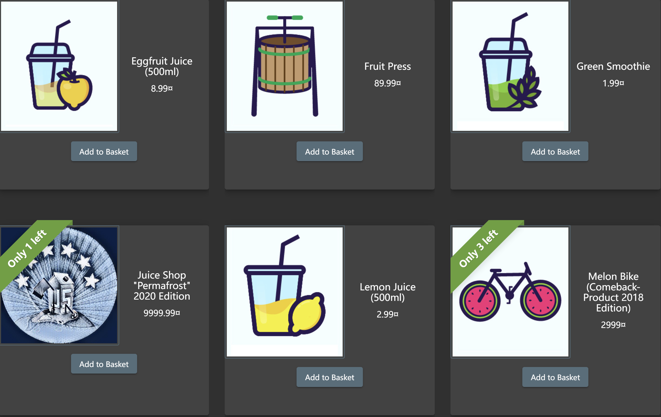
II. Vulnerability 1: SQL injection
Motivation: Short of money! Or juice for better live!
Try: Log in other people's accounts to buy things for myself.

Slide 7
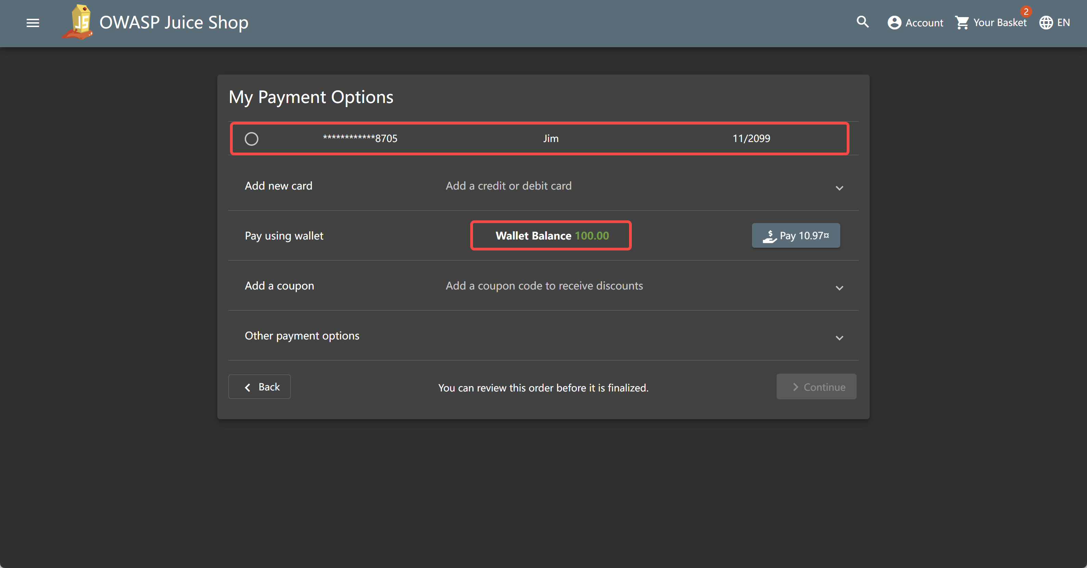
II. Vulnerability 1: SQL injection
Why ? — #1 Password-free payment
I can use the money on the account to buy anything without password, once I login in.

Slide 8
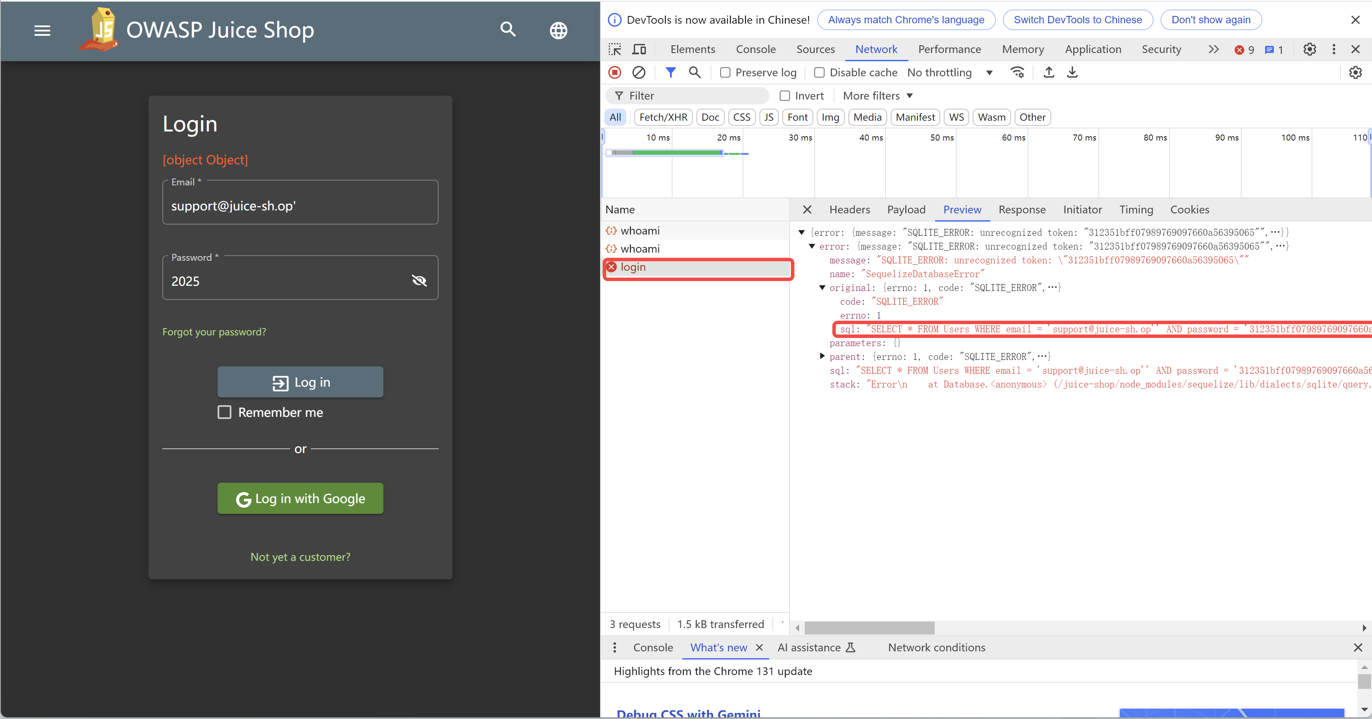
II. Vulnerability 1: SQL injection
Why ? — #2 SQL injection is here
Add ‘ in the email, error is raised and SQL command can be find out in Network

Slide 9
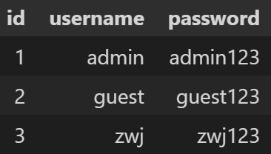
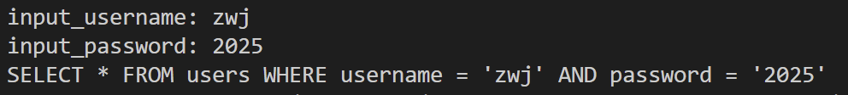
II. Vulnerability 1: SQL injection
Why ? — #3 Codes after ”--” become invalid！
DATABASE
query = f"SELECT * FROM users WHERE
username = ‘{input_username}’
AND
password = ‘{input_password}'"
Response: None
User dont exists！
Login failed
Response: (3, ‘zwj‘, ‘zwj123')
User exists！
Login successfully

Slide 10
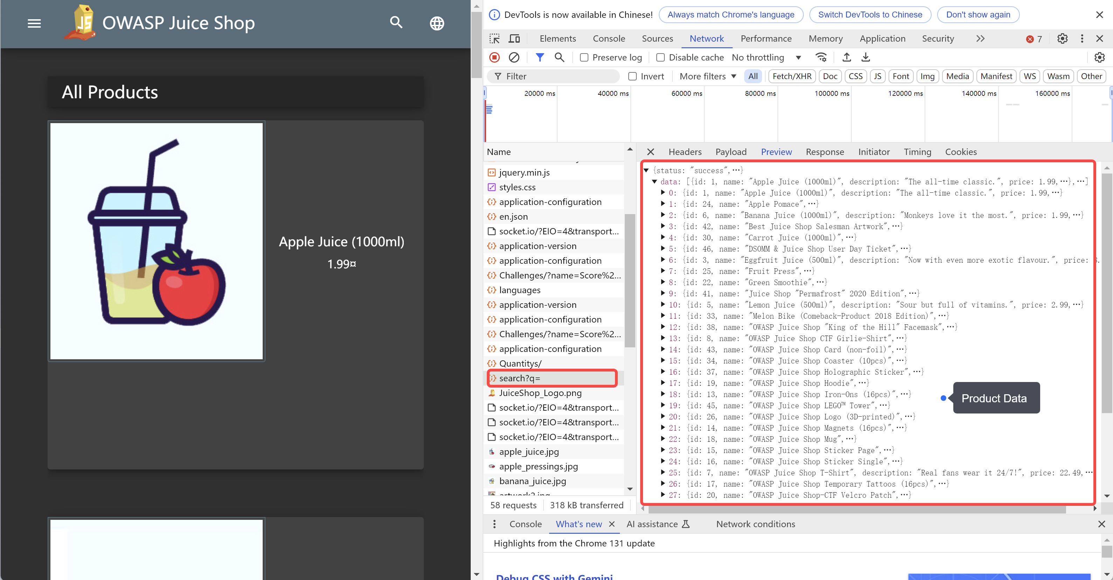
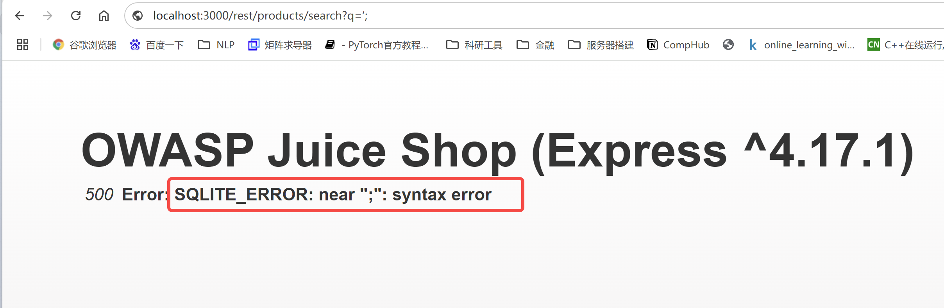
II. Vulnerability 1: SQL injection
What ? — Step #1 Find SQL injection point
Collect all users’ account
SQL Inject to attack the Verification of login
Buy things using money on account
Open http://localhost:3000 /#/search and reload the page with F5 , observing the Network in browser’s DevTools
http://localhost:3000/rest/products/search?q= returns the product data.
Search: http://localhost:3000/rest/products/search?q=‘;
q = ‘;
Indicate SQL Injection is
indeed possible！

Slide 11
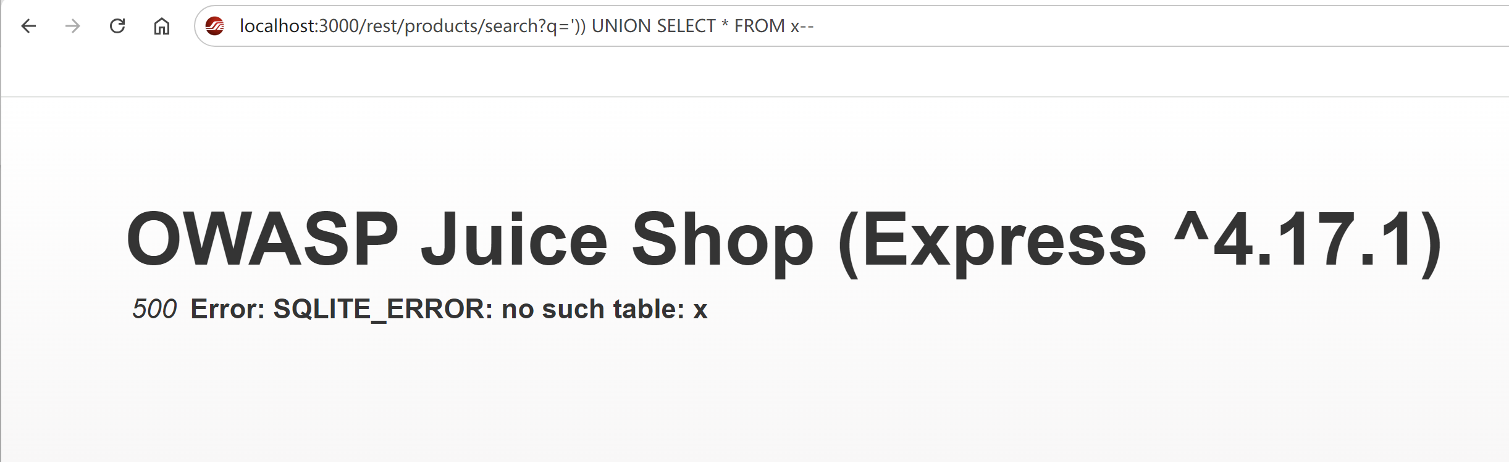
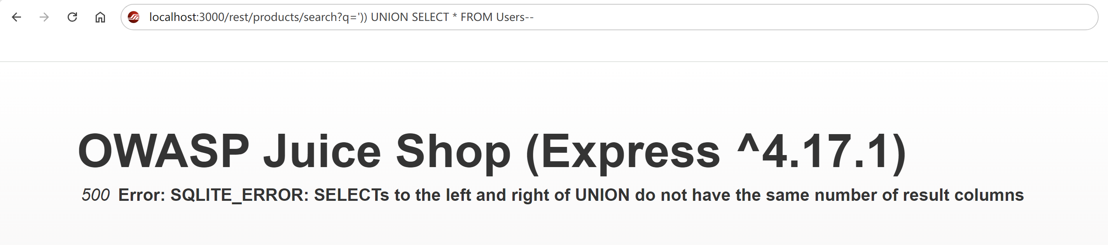
II. Vulnerability 1: SQL injection
What ? — Step #2 Do SQL injection
Collect all users’ account
SQL Inject to attack the Verification of login
Buy things using money on account
q
')) UNION SELECT * FROM x --
SQLITE
ERROR
no such table: x
Guess the table name !
q
')) UNION SELECT * FROM Users --
SQLITE
ERROR
The left and right of UNION do not have the same number of result columns
Yes! We get table name “users”

Slide 12
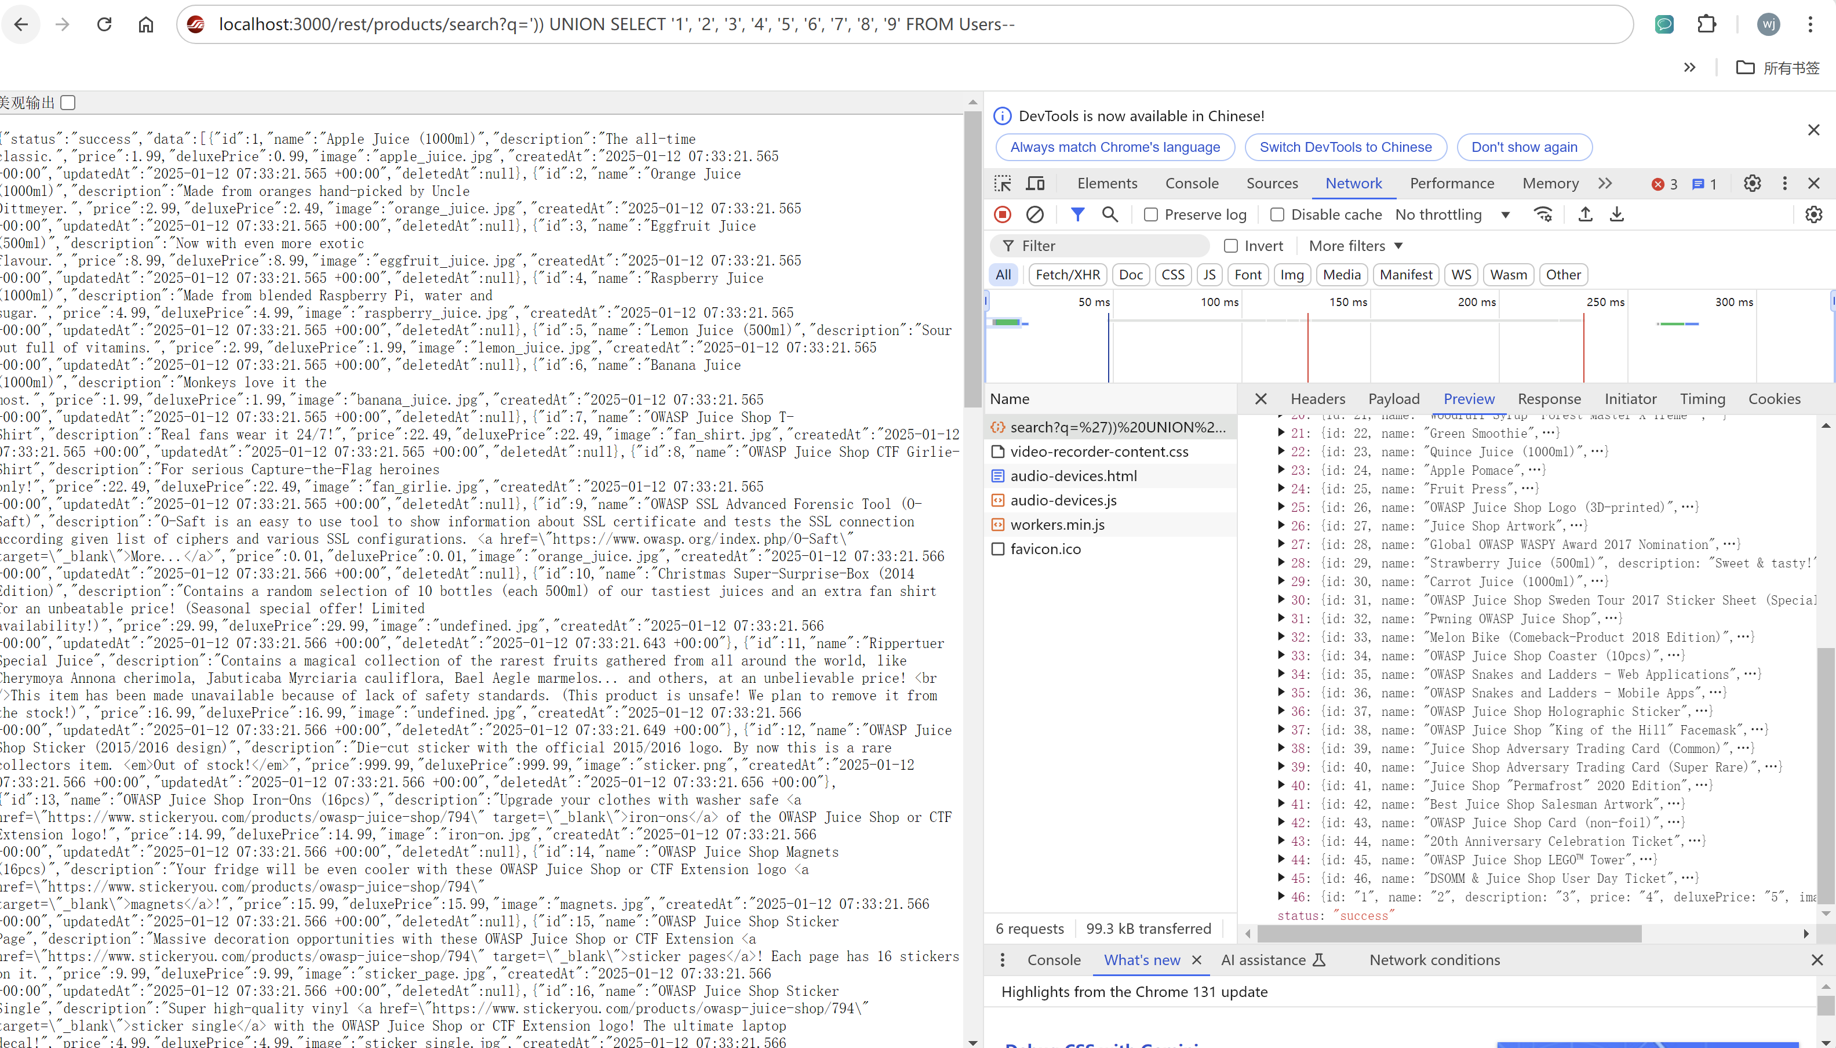
II. Vulnerability 1: SQL injection
What ? — Step #3 Get the User’s Account
Collect all users’ account
SQL Inject to attack the Verification of login
Buy things using money on account
Find the right number of returned columns
q
')) UNION SELECT ‘1’ FROM Users --
')) UNION SELECT ‘1’,’2’ FROM Users --
‘)) UNION SELECT ‘1’,’2’,’3’, ‘4’,’5’,’6’, ‘7’,’8’,’9’ FROM Users --
Yes ! We got right number of returned columns!!!
But there is no users’ information in the response.
That’s because ‘1’,’2’ … are not right column names.
We should guess the right column name that contains information needed.

Slide 13
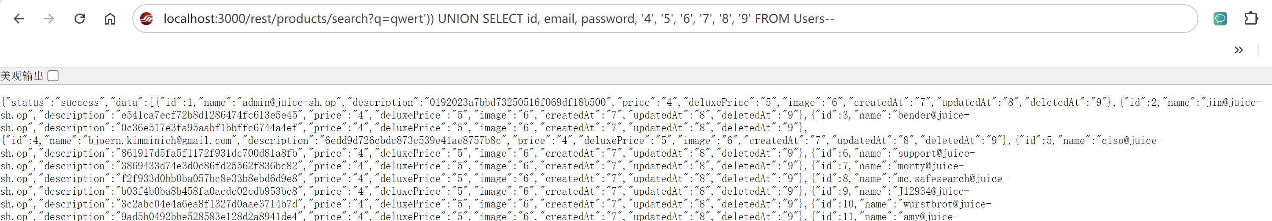
II. Vulnerability 1: SQL injection
What ? — Step #3 Get the User’s Account
Collect all users’ account
SQL Inject to attack the Verification of login
Buy things using money on account
Guess the right column name we need! It’s easy!
qwert')) UNION SELECT id, email, password, '4', '5', '6', '7', '8', '9' FROM Users--
q
q is used for goods selected.
Let q=qwert or any other word to selected no goods and just return the users’ information

Slide 14
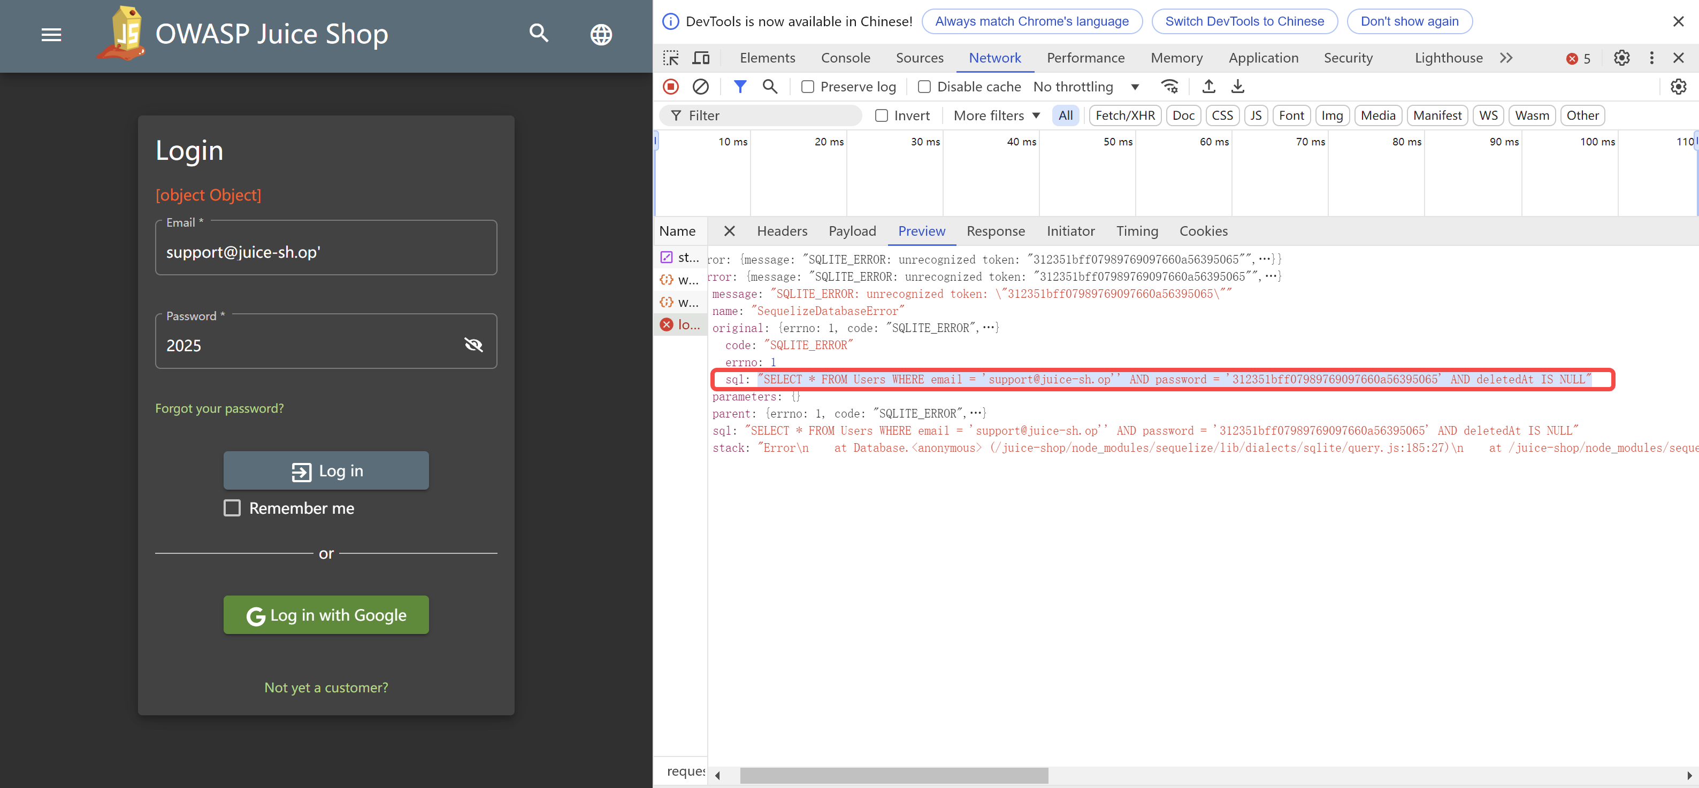
II. Vulnerability 1: SQL injection
What ? — Step #4 Log in using other’s account
Collect all users’ account
SQL Inject to attack the Verification of login
Buy things using money on account
Get the sql command
‘SELECT * FROM Users
WHERE
email = ‘support@juice-sh.op‘’
AND
password = '312351bff07989769097660a56395065’
AND
deletedAt IS NULL’
Guess that when len(result of sql) !=0, we will login successfully.
Because the password is encrypted, it is necessary to bypass the password.
Input:
support@juice-sh.op’--
Use -- to Comment out
the code that follows
The sql command will be
‘SELECT * FROM Users WHERE email = ‘support@juice-sh.op‘’--….

Slide 15
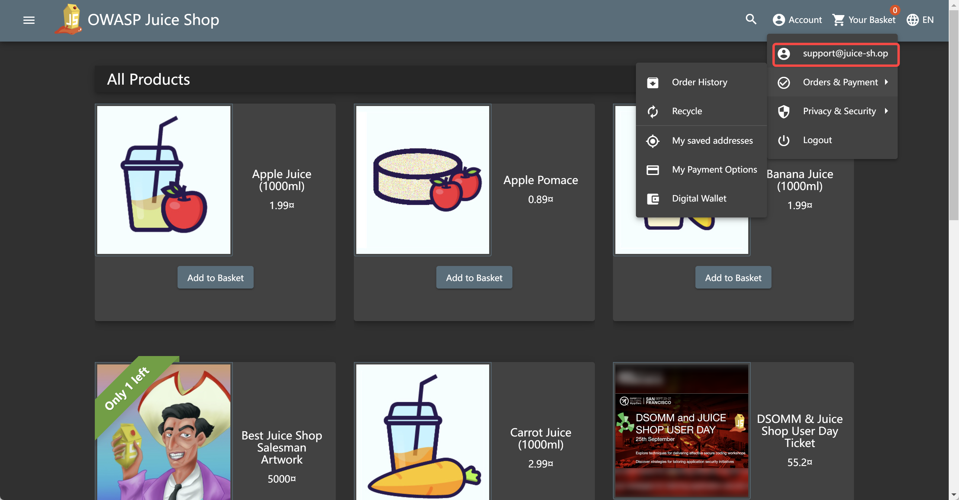
II. Vulnerability 1: SQL injection
What ? — Step #5 Buy items
Collect all users’ account
SQL Inject to attack the Verification of login
Buy things using money on account
Input:
support@juice-sh.op’--
Use -- to Comment out
the code that follows
The sql command will be
‘SELECT * FROM Users WHERE email = ‘support@juice-sh.op‘’--….
Successfully!
Do the same to every account
Use their money to buy some goods !!!

Slide 16
II. Vulnerability 1: SQL injection
How ? — How to make the mitigation for this BUG ?
Prepared Statements (with Parameterized Queries)
Pass input_name and input_password as parameters to the SQL command execution function.
The database will always distinguish between code and data, regardless of what user input is supplied.
DATABASE
input_name = zwj’--
input_password = 2025
Response: None
User dont exists！
Login failed
No username equals zwj’--

Slide 17
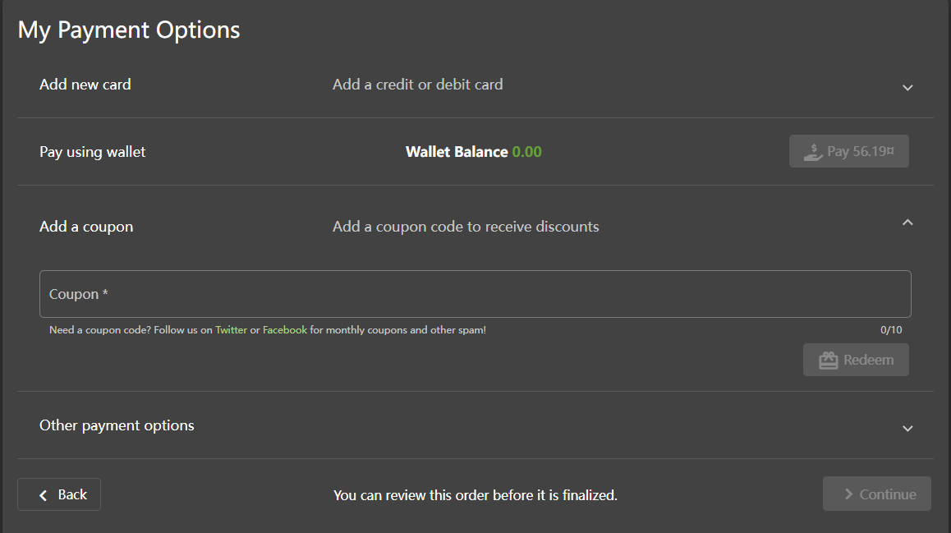
III. Vulnerability 2: Reversible Encryption
Motivation: Short of money! Make everyday Double 11!
Try: Forge coupons to achieve super-high discounts.
Notes:
As a hacker, we may lack money because we cannot crack websites effectively, or we just want to make everyday Double 11!
In this issue, we will forge coupons to achieve super high discounts!

Slide 18
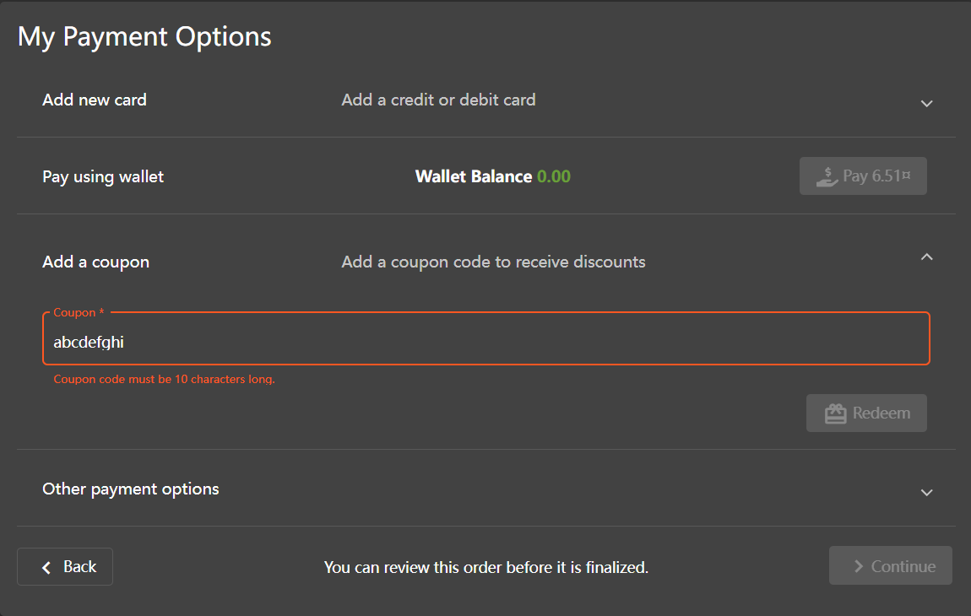
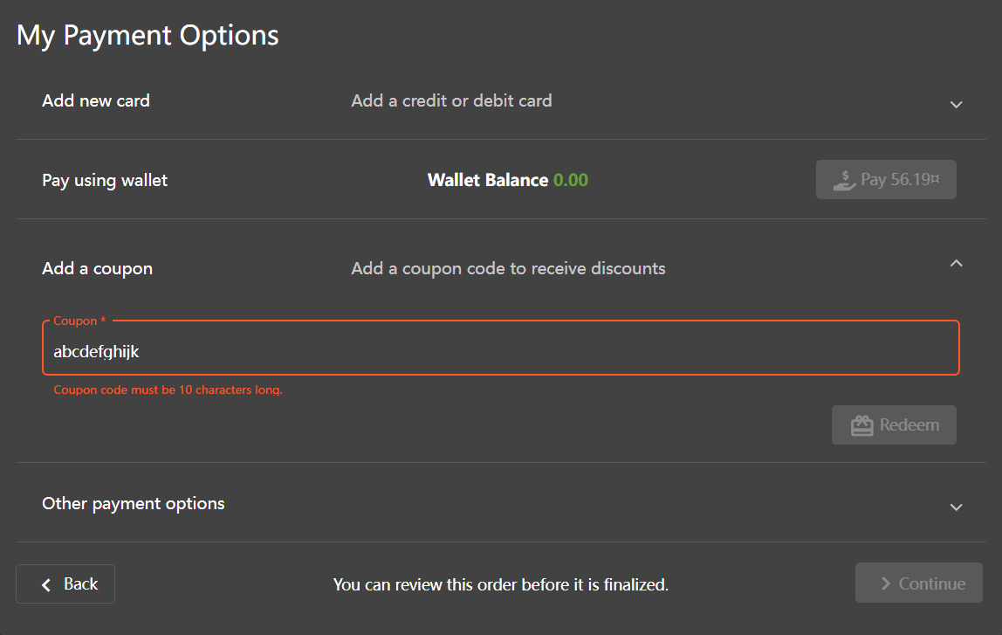
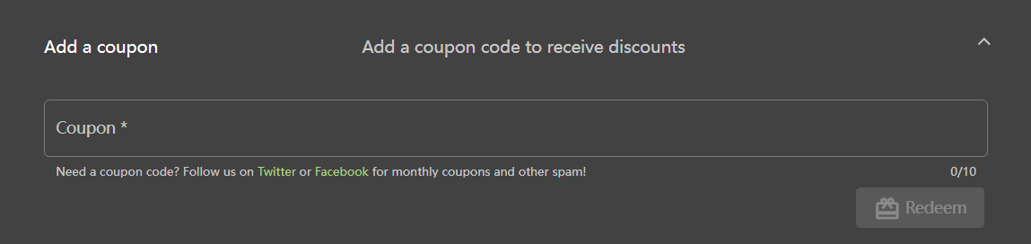
III. Vulnerability 2: Reversible Encryption
Why ? — #1 Unrestricted coupons
There is no restriction on the usage of coupons.
Once forged successful, the coupon will be universal.
Notes:
So why it is possible to do this? To begin with, there is no restriction on the usage of coupons, which means that once forged successful, the coupon will be universal for all items!

Slide 19
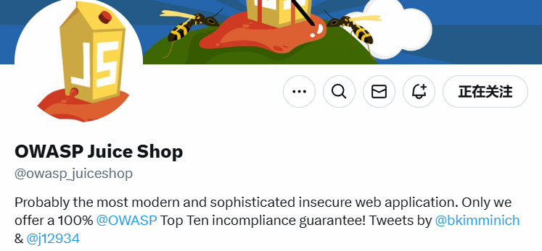
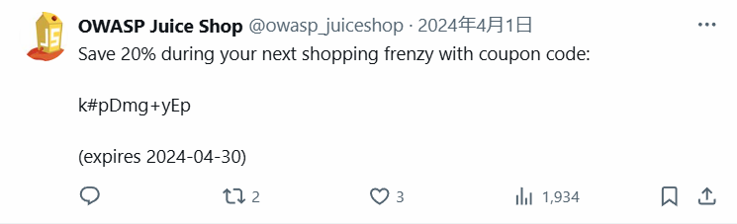
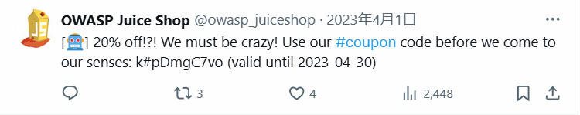
III. Vulnerability 2: Reversible Encryption
Why ? — #2 Imperfect Reversible Encryption
Expiration | Discount | Coupon
2024-04-30 | 20% | k#pDmg+yEp
2023-04-30 | 20% | k#pDmgC7vo
2023-03-31 | 40% | o*IVjgC7Bq
2023-02-28 | 30% | mNYT0gC7yp
2023-01-31 | 20% | n<MicgC7vo
2022-12-31 | 40% | l}6D#ga+sp
2022-11-30 | 40% | pes[Cga+sp
2022-10-31 | 30% | pEw8pga+po
2022-09-30 | 20% | q:<Irga+mn
2022-08-31 | 30% | k#*Agga+po
2022-07-30 | 30% | n(XLuga+po
2022-06-30 | 30% | n(XRwga+po
Regularity shows that the decryption must be some simple method rather than hash.
Notes:
Besides, if we try to gather the previous coupons together, the regularity shows that the decryption must be some simple method rather than hash.

Slide 20

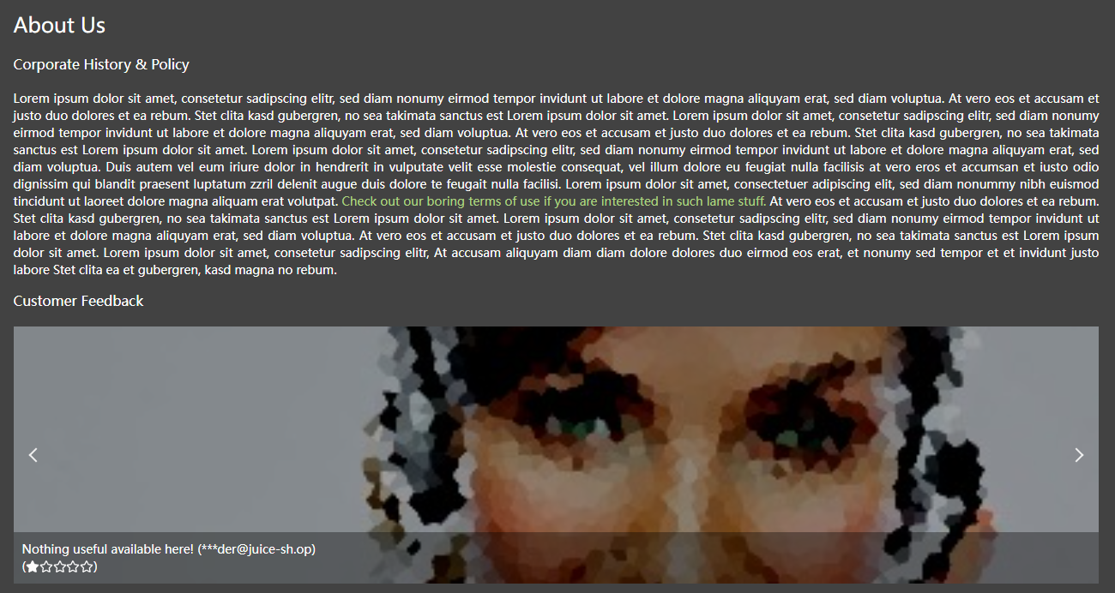
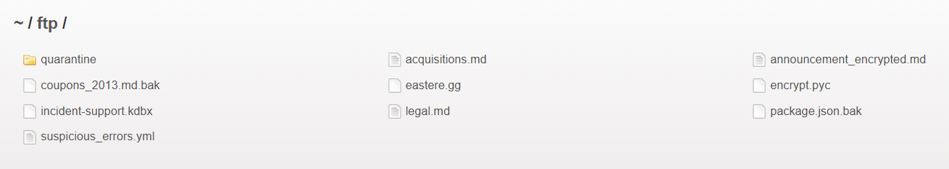
III. Vulnerability 2: Reversible Encryption
What ? — Step #1 Find the core file access portal
Go through files of the application
Capture the communication content from server when inputting the coupon
Brute force attack
About Us (http://127.0.0.1:3000/ftp/legal.md), try http://127.0.0.1:3000/ftp
Notes:
So the task we need to do next is to find the encryption algorithm of the coupon. But it’s easier said than done, after trying various possible ways including capturing the communication content from server when inputting the coupon , brute-force attack and so on, we finally found the core file access portal in the parent directory of About Us!

Slide 21
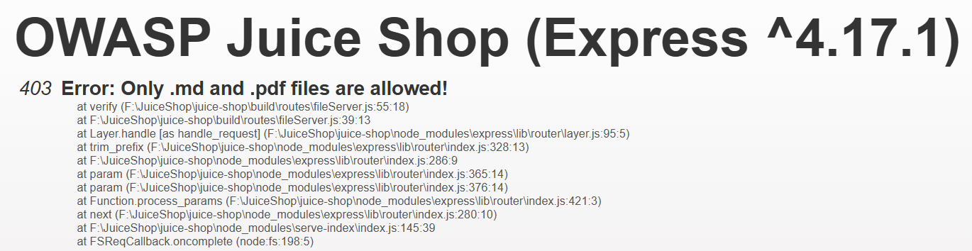
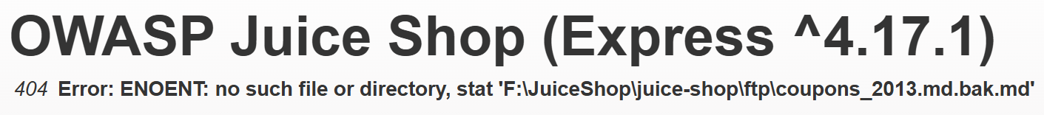
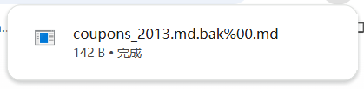
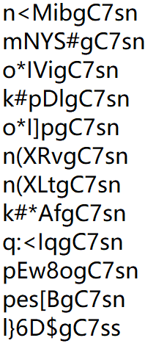
III. Vulnerability 2: Reversible Encryption
What ? — Step #2 Try Poison Null Type Attack to get core files
http://127.0.0.1:3000/ftp/coupons_2013.md.bak
http://127.0.0.1:3000/ftp/coupons_2013.md.bak.md
http://127.0.0.1:3000/ftp/coupons_2013.md.bak%2500.md
%2500 is decoded as %00 (null byte). When the web server parses this path, it treats the filename as coupons_2013.md.bak, thus bypassing the file extension check
Notes:
It was said that only .md and .pdf are allowed, but even after adding .md, we do not have the permission to access the file directly, but we can bypass the permission check by inserting an empty byte to obtain the md file, which is called Poison Null Type Attack. And we found that there are some coupons for 2013 in the file file coupons_2013.md.bak!

Slide 22
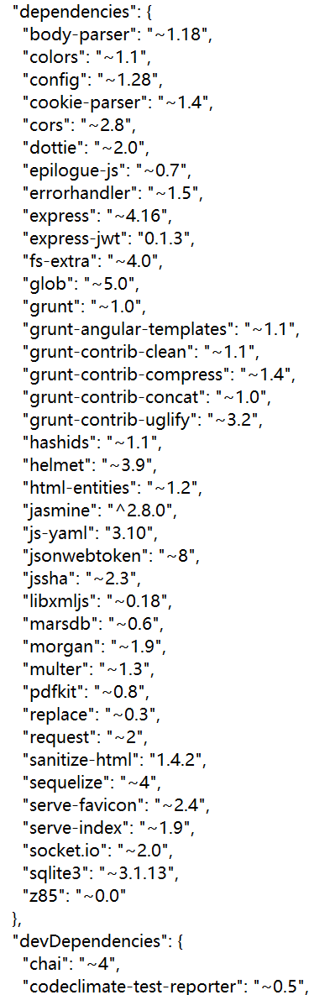
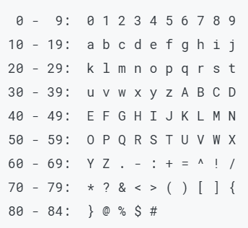
III. Vulnerability 2: Reversible Encryption
What ? — Step #3 Go through core files to find out the algorithm
http://127.0.0.1:3000/ftp/package.json.bak%2500.md
The encryption algorithm was found —— z85
Step1:Split data into 4-byte blocks (Do padding if not a multiple of 4 bytes)
Step2: Treat each 4-byte block as a 32-bit integer and calculate its value M.
Step3: Calculate M % 85, (M // 85) % 85 … and map them to characters.
Notes:
After going through all the files in ftp, finally, in package.json.bak, we found that the encryption algorithm is z85! z85 is a simple bidirectional /ˌbaɪdəˈrekʃənl/ reversible mapping algorithm, which means we can get the plaintext of the coupon easily!

Slide 23
III. Vulnerability 2: Reversible Encryption
What ? — Step #4 Figure out the pattern of coupon
Expiration | Discount | Coupon | Decryption
2024-04-30 | 20% | k#pDmg+yEp | APR24-20
2023-04-30 | 20% | k#pDmgC7vo | APR23-20
2023-03-31 | 40% | o*IVjgC7Bq | MAR23-40
2023-02-28 | 30% | mNYT0gC7yp | FEB23-30
2023-01-31 | 20% | n<MicgC7vo | JAN23-20
2022-12-31 | 40% | l}6D#ga+sp | DEC22-40
2022-11-30 | 40% | pes[Cga+sp | NOV22-40
2022-10-31 | 30% | pEw8pga+po | OCT22-30
2022-09-30 | 20% | q:<Irga+mn | SEP22-20
2022-08-31 | 30% | k#*Agga+po | AUG22-30
2022-07-30 | 30% | n(XLuga+po | JUL22-30
2022-06-30 | 30% | n(XRwga+po | JUN22-30
plaintext of coupon is in format
“Month Year -Discount”
We could easily forge a coupon with a 99% discount expiring on January 31, 2025.
JAN25-99
ASCII: 74, 65, 78, 50, 53, 45, 57, 57
01001010 01000001 01001110 00110010
00110101 00101101 00111001 00111001
Block 1 = 1245796009
Block2 = 880753481
1245796009 % 85 = 12 → n
(1231729730 // 85) % 85 = 54 → <
……
n<Mich7Z*G
Notes:
So after decrypting all the coupons, we know that the format is Month Year -Discount! After inputting JAN25-99, we can get the coupon we want!

Slide 24
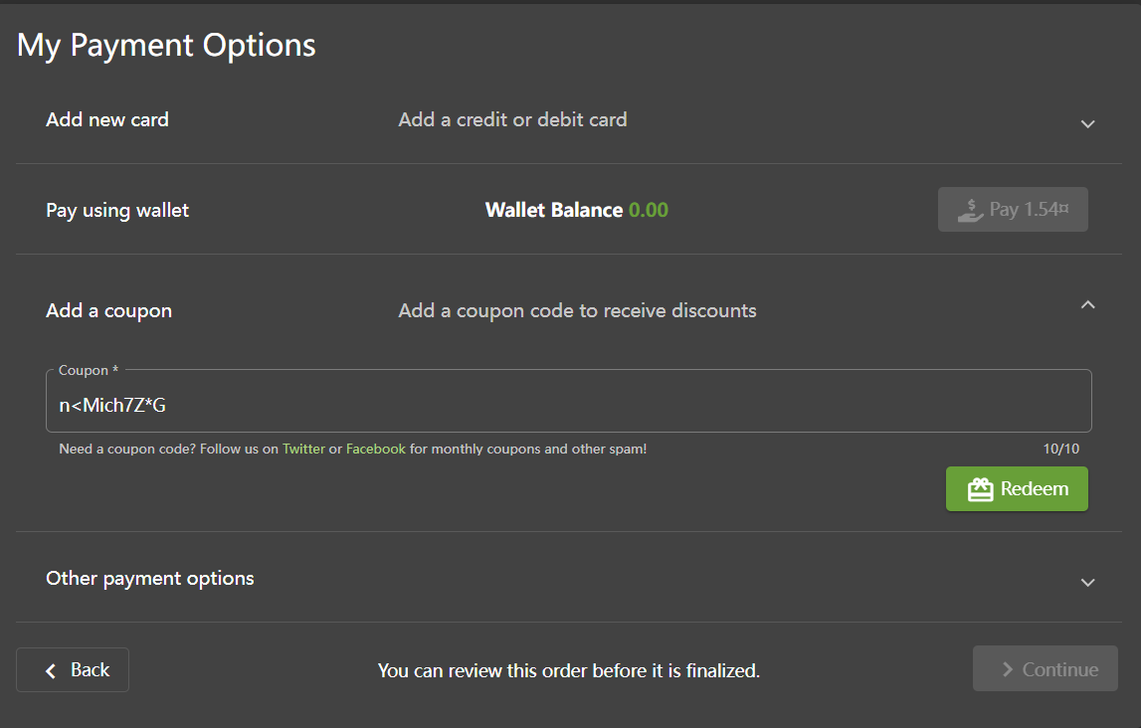
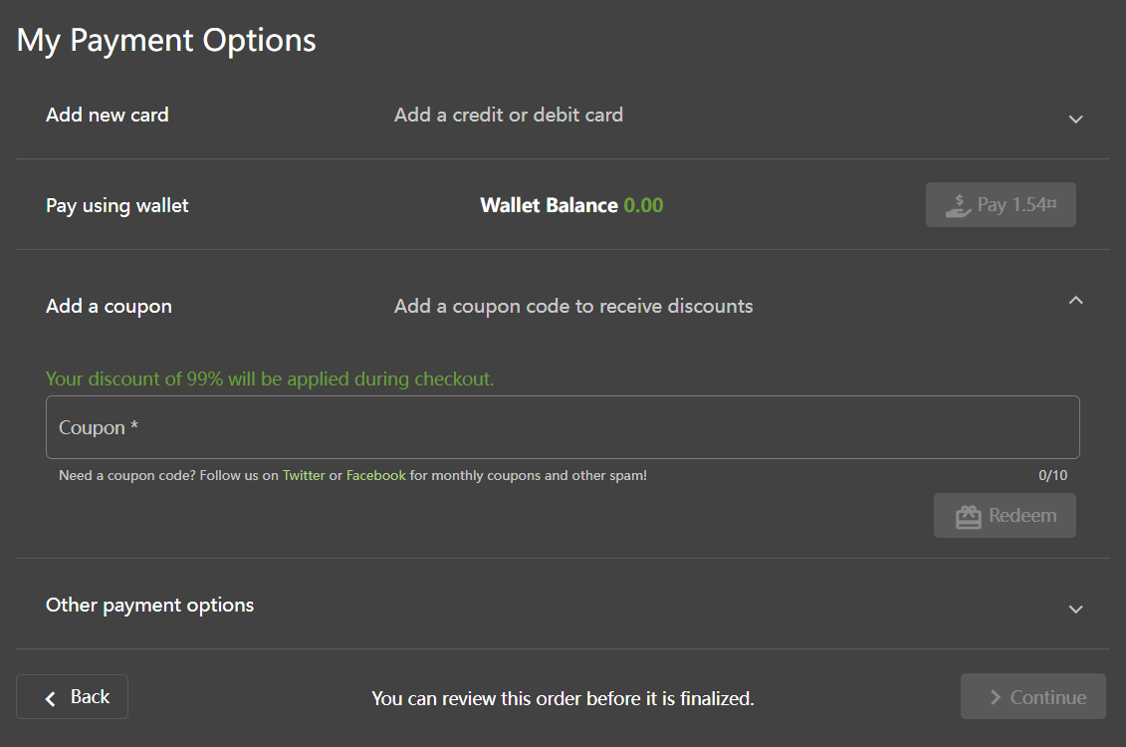
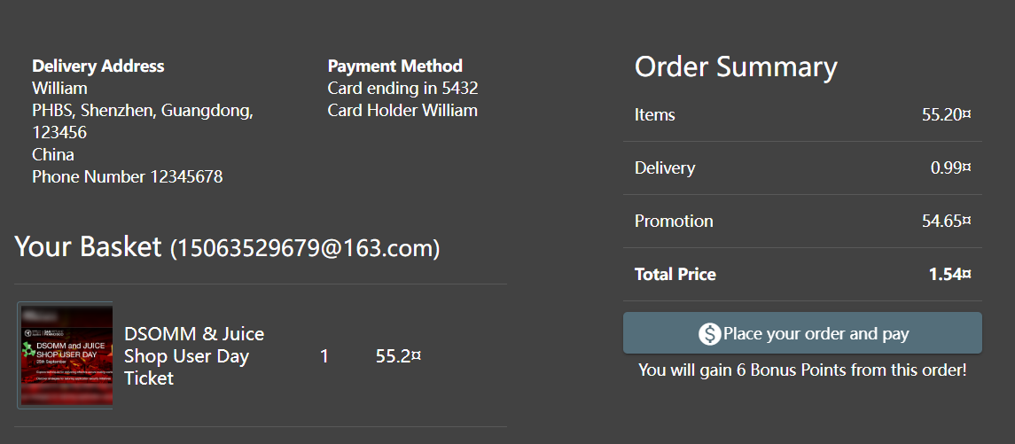
III. Vulnerability 2: Reversible Encryption
What ? — Step #5 Use forged coupons
Successfully!
We can purchase any item at any discount
Notes:
And, after inputting the coupon, we achieved 99% discount successfully ! From now on, We can purchase any item at any discount!

Slide 25





III. Vulnerability 2: Reversible Encryption
How ? — How to make the mitigation for this BUG ?
Properly identify null fields to deal with the Poison Null Type Attack
Use Hash + Salt instead of z85 to deal with reverse engineering
Check the validity of the coupon on the server, not locally
Users may bypass the validity check by tampering with the local system time
Admin
JAN25-30
abc123
7394eef0d04fff25c069e7dcfa196a515fae9a054d4fa87c8f1944eb6dec0ebe
Coupon
Salt
Ciphertext
Users
7394eef0d04fff25c069e7dcfa196a515fae9a054d4fa87c8f1944eb6dec0ebe
Ciphertext
Server
Database
Notes:
So the last question is how to make the mitigation for this BUG? Looking back at the process of hacking the system, there are three vulnerabilities that urgently need to be fixed.
Properly identify null fields to deal with the Poison Null Type Attack
Use Hash + Salt instead of z85 to deal with reverse engineering
Check the validity of the coupon on the server, not locally
So as a kind hacker, I’d like to remind you that be careful with your file system and your coupons! Once leaked, the losses will be enormous!

Slide 26




IV. Vulnerability 3: Bypassing CAPTCHA
Why ? — Someone wants to give bad feedback.
I'm Harry.
I used to be a loyal user of Juice Shop

Slide 27


IV. Vulnerability 3: Bypassing CAPTCHA
Why ? — Someone wants to give bad feedback.
One day I was using Juice Shop to buy something
and I got hacked by a hacker called ZWJ,
I have no money left, this crap site has no protection at all, I'm going to give a bad review!

Slide 28
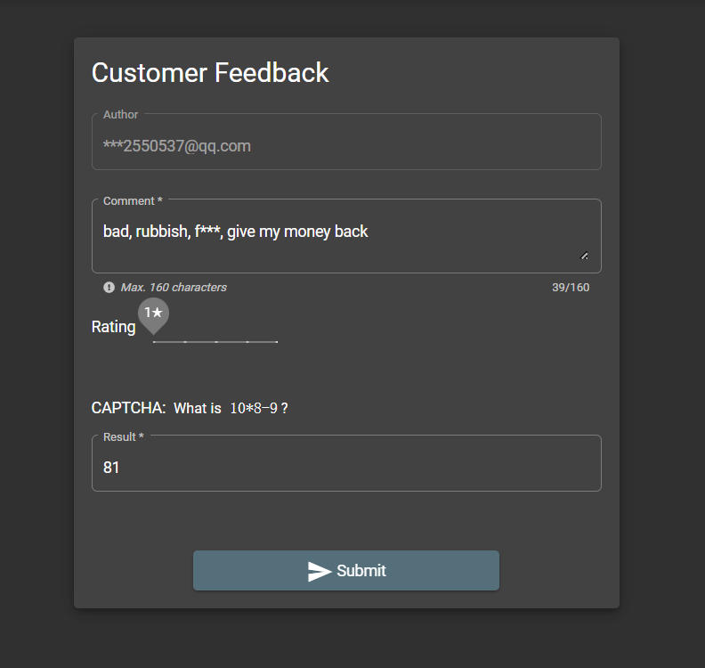

IV. Vulnerability 3: Bypassing CAPTCHA
Why ? — Need to pass the CAPTCHA.
So I went to this feedback page, bad reviews, one star, all scheduled on
Gosh, one bad review is even less than I hate, I'm going to type more bad reviews! But I don't have the money to buy a merc, so I'll be my own merc!

Slide 29
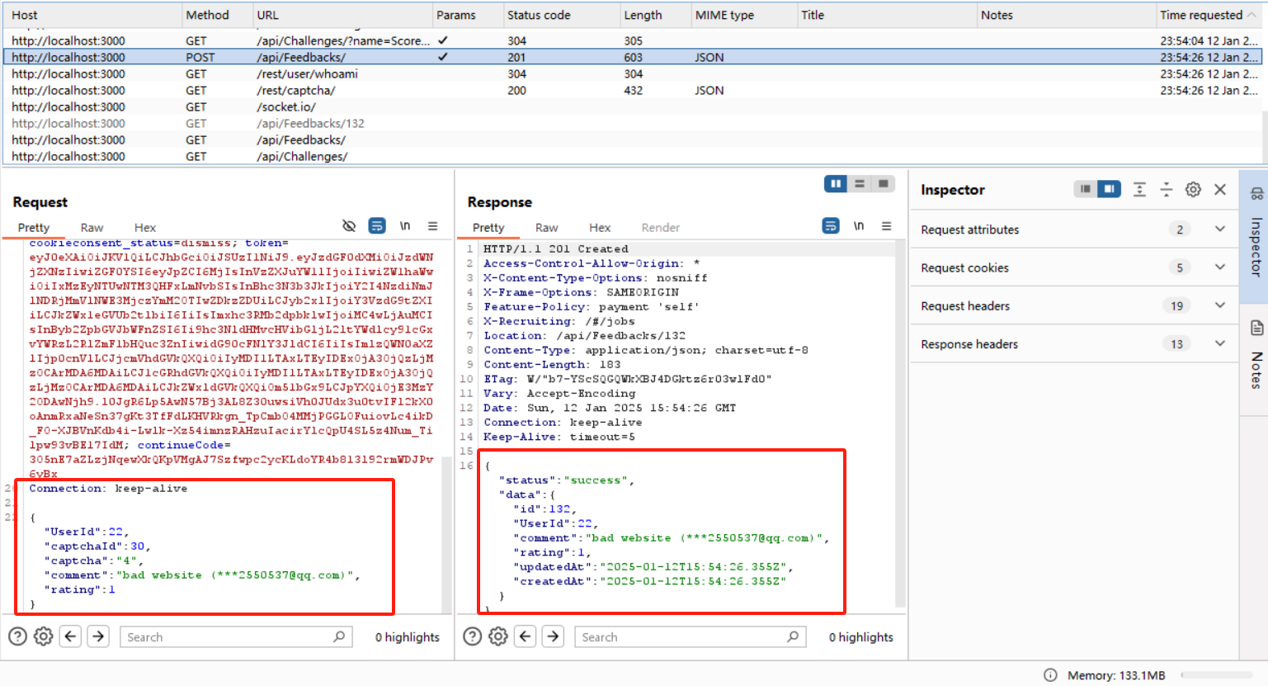
IV. Vulnerability 3: Bypassing CAPTCHA
it is possible to intercept the request sent by the site and just change the COMMENT
Be possible to duplicate the submission!
Unfortunately, the bug has been officially fixed
We need a new method!
Notes:
至少我有一点点技术，我在网上了解到对于Juice Shop，可以截取到网站发送的request，只需要改变comment，发现原来可以重复提交！可惜官方已经修复了这个bug，我需要尝试新的方法
At least I have a little bit of skill, I learned online that for Juice Shop, it is possible to intercept the request sent by the site and just change the COMMENT, and found out that it turns out to be possible to duplicate the submission! Unfortunately the bug has been officially fixed and I need to try a new method

Slide 30

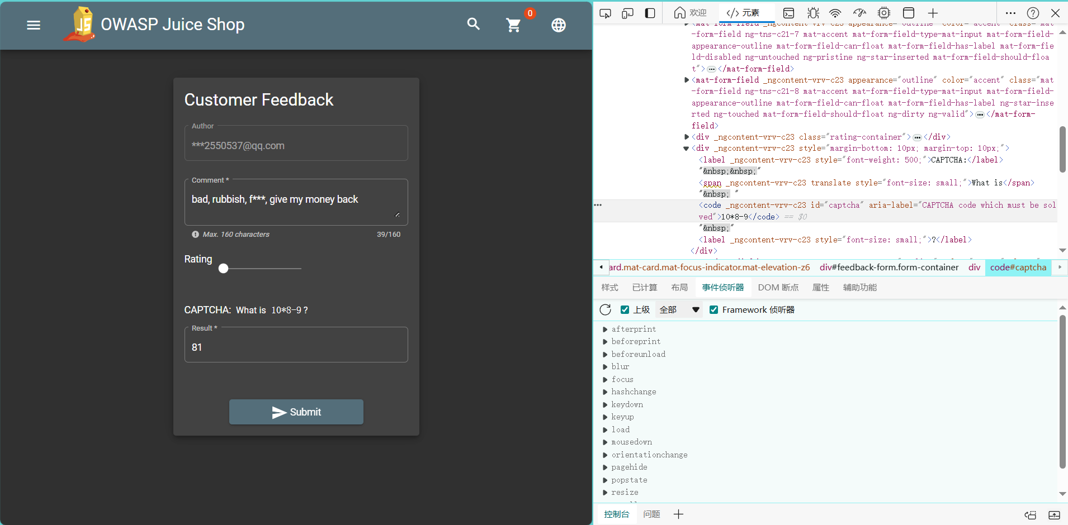
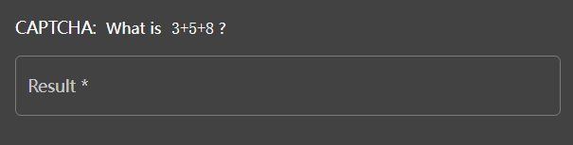
What ? — Execute the plaintext.
verification here is presented using textual information
directly presented using CAPTCHA
Find the textual content corresponding to the CAPTCHA
String
“3+5+8”
expression (math.)
get answers
3+5+8=16
Input and validation
Notes:
Discovered that the verification here is presented using textual information, while the webpage is directly presented using CAPTCHA
In other words, we can read the CAPTCHA, write a script using Python, and just compute the expression corresponding to the string by directly calculating the

Slide 31

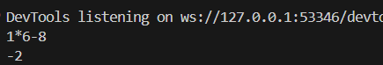
What ? — Execute the plaintext.
DevTools listening on ws://127.0.0.1:53346/devtools/browser/e8220416-4372-46ef-a389-2f76f26d8788
1*6-8
-2
Notes:
You can see that the program reads the formula and calculates the result at the same time, and then finally hands over this evaluation, so that you can automatically brush the comments

Slide 32
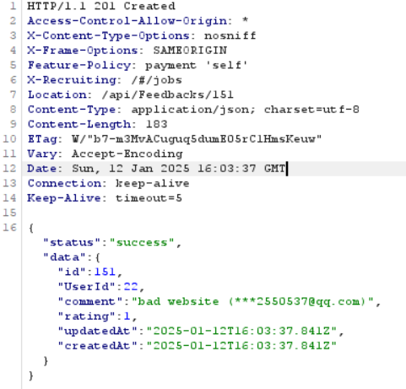
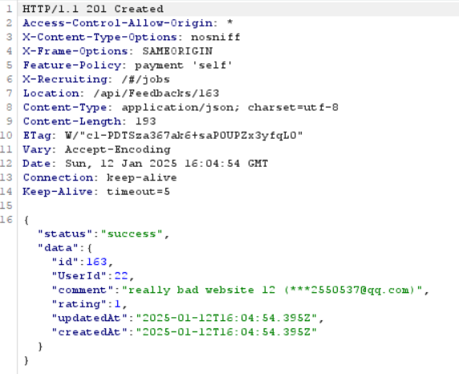
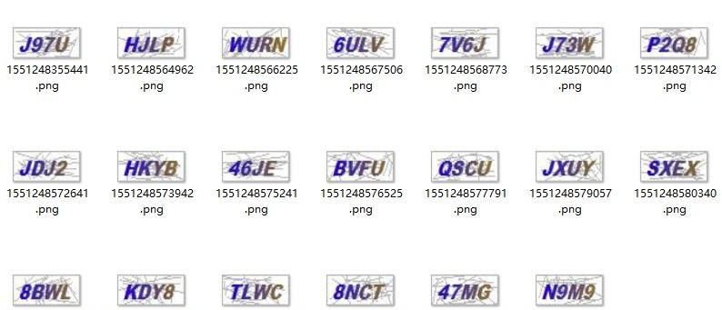
What ? — Execute the plaintext.
Using the tool found that we successfully submitted 12 malicious comments (more than 12, of course), while the responses given were all successful
Is that the end?
Then Juice Shop officials they noticed me and knew that I was swiping malicious reviews
They tried to fix the bug: switched the validation method, using images instead of direct text
Notes:
Then Juice Shop officials they noticed me and knew that I was swiping malicious reviews and how I was doing automated review swiping
They tried to fix the bug: switched the validation method, using images instead of direct text
Is that the end?

Slide 33
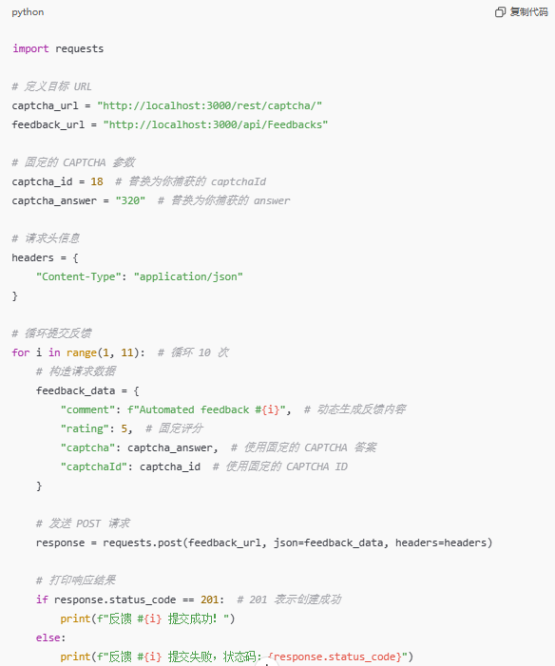
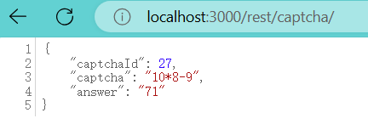
What ? — Find the answer.
One way or another, I'll find the answer
Discover that the website stored relevant information on the front end
JSON
URL
Step 1: Directly look for the captcha storage address,
Step 2: find the relevant information, Step 3: directly post,
Step 4: successfully bypassing
Notes:
换句话说无论你使用何种的输入验证，我都可以在这个前端的表单中找到你的答案

Slide 34


How ? — How to make the mitigation ?
1 Use of unique authentication methods such as labeling, human machine recognition
2 Still using image captcha
But why？
Simple and easy to implement
Low development costs
No external services required
Protection needs to be done:
Can‘t use about relevant information in front-end or URL forms, put it in the server
Time-sensitive, unique CAPTCHA
Protection of relevant information
Notes:
简单易实现
开发成本低：图片验证码实现简单，只需生成一张包含干扰的图片并验证输入即可。对小型开发团队或资源有限的项目，这是一种容易实现的解决方案。
无需外部服务：人机验证（如 Google reCAPTCHA）需要依赖外部 API 服务，可能引入隐私、费用或网络连接问题。而图片验证码可以完全自给自足。

Slide 35






V. Conclusion: SQL injection
Summary and key techs
Find Injection Entry
SQL Injection
Log in with other users’ accounts.
Inject by “UNION SELECT”
Use of `--`
UNION
Log in by annotating.
Practical Significance and Lessons Learned
Most Frequent
Fig. 5.1 Distribution of web application critical vulnerabilities worldwide as of 2023
Business Impact Analysis
Direct Financial Impact
Data breach costs
Customer compensation
System remediation
Legal penalties
Business interruption
Indirect Consequences
Reputation damage
Loss of customer trust
Reduced market value
Increased insurance premiums
Regulatory scrutiny
Cases in Reality
Notes:
The attack chain begins with a simple authentication bypass using the payload `jim@juice-sh.op'--` and to find the entry. The vulnerability allows attackers to execute UNION-based SQL queries, enabling the extraction of sensitive user credentials from the database. A Rainbow Table attack is a cryptographic attack that uses precomputed password hashes to crack password more efficiently than brute force methods.
SQL injection vulnerability reveals several significant data breaches in recent years, it ranks first in the web application critical vulnerabilities worldwide in 2023.
the 2012 LinkedIn, resulting in the exposure of 6.5 million password hashes, demonstrates the cascading effects of SQL injection vulnerabilities when combined with inadequate password storage practices. A recent study by Positive Technologies found that 82% of web applications remain vulnerable to SQL injection attacks at some level. This statistic becomes more alarming when considering that 97% of these vulnerabilities could be exploited without authentication.

Slide 36










V. Conclusion: Reversible Encryption
Summary and key techs
Null Byte Injection
coupons_2013.adoc.bak
Forge a coupon code that gives you a 99% discount.
Reversible Encryption Algorithm z85
z85 -d “Coupon code”
Regularity of Promo Code Format
JAN17-50: At Jan 17th, the coupon offers 50% discount
Practical Significance and Lessons Learned
Common Points
Reversible Encoding/Encryption Algorithms(like base64, z85)
Lack of Replay Attack Prevention
No Traffic Control Implementation
Insufficient Anomaly Detection
Industrial chain derivative risk
···
Generate
Sell
Decrease profit
Buy
Raise Price
Cases in Reality
Use coupons
Notes:
Vulnerability,
As eCommerce rapidly expands, Coupon Code Forgery vulnerability attracts hackers’ attention and causes huge economic damage. in 2016, Uber faced vulnerabilities in their promotional code system where researchers discovered patterns in their code generation algorithm, allowing potential manipulation of discount values. These incidents share common characteristics with our simulated attack. Attackers generate coupons, selling them through underground markets. This creates a shadow economy that not only damages business revenue but also distorts market dynamics and erodes consumer trust. Undertake the results and risks,

Slide 37



V. Conclusion: Bypassing CAPTCHA
Summary and key techs
CAPTCHA in Plaintext
Submit 10 or more customer feedbacks within 10 seconds
CAPTCHA Flaws
CAPTCHA-pinning
CAPTCHA easily Guessable
Practical Significance and Lessons Learned
Consequences of Such Attacks
Spam and Fake Accounts
Abuse of Resources:
Vote & Review Manipulation
User Privacy & Account Security:
Brute-force & Account takeover
Larger-scale attacks (DDoS)
Increased Threat Levels:
Social engineering attacks
Financial & Reputational Damage:
Eg, Fake refund requests
Cases in Reality
Notes:
CAPTCHA challenge is not dynamically tied to the specific instance of the challenge. Instead, it can be reused or "pinned" across multiple requests, bypassing the intended challenge-response mechanism.
CAPTCHA (Completely Automated Public Turing test to tell Computers and Humans Apart) serves as a security mechanism designed to distinguish human users from automated bots. Simulated CAPTCHA attacks demonstrate how CAPTCHA mechanisms can be bypassed, offering valuable insights into the vulnerabilities of these systems. It is significant since If such attacks are executed in real scenarios, they can lead to severe consequences:
Harass innocent uers
We implemented various attacks ，Validated the vulnerabilities in a controlled, real-world environment. Explored countermeasures to prevent or mitigate these attacks.
This project demonstrates the vital importance of secure coding practices and robust security controls in modern web applications. By understanding potential vulnerabilities, we're better equipped to design and implement secure systems that protect user data and maintain application integrity

Slide 38
Thank You
13rd Jan, 2025
Group Members: Kai Ren, WeiJie Zhang, YiMing Jiang, Rui Hu, Yang Lan

